Slide 1

Job Resume–Job Description Matching
Predict whether a resume is a good fit for a given job posting.
Name :
M Niranjan - PES2UG23CS308
Keerthan P V - PES2UG23CS272

Slide 2
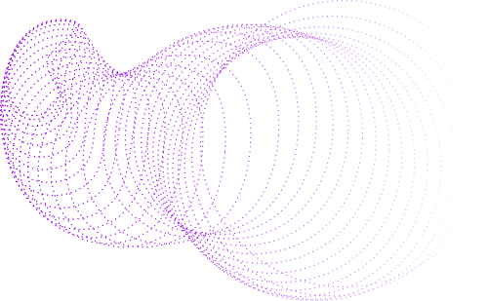
Objectives
Automate resume–JD evaluation using NLP and ML to:
Classify resumes by category (e.g., Good ,moderate,bad).
Measure semantic similarity and keyword overlap with job descriptions.
Generate match scores and insights.
Motivation
Reduce recruiter effort by automating:
Resume classification and JD–resume matching.
Explainable scoring and keyword visualization.

Slide 3
System Architecture
Components:
Resume Parsing: PDF extraction via PyPDF2.
Text Preprocessing: Cleaning, lemmatization, removing stopwords & generic terms.
Embedding & Feature Engineering:
Sentence Transformer embeddings (MiniLM)
TF-IDF & Count Vectorizer
Combined for ML classifier.
Resume Classification: Random Forest classifier predicts category.
Resume–JD Matching:
Cosine similarity of embeddings
Keyword overlap & coverage score
Composite match score
Visuals:
Flow diagram with arrows: PDF → Preprocessing → Embeddings → Classifier → Match Analysis.

Slide 4
Classification Model
RandomForestClassifier with:
n_estimators=300, max_depth=20
Balanced class weights
Combined embeddings + TF-IDF + Count features
Technical Stack
Frameworks:
Streamlit (Web UI)
PyTorch (Model fine-tuning)
scikit-learn (Classification, metrics)
Libraries:
Sentence Transformers
NLTK (Text preprocessing)
PyPDF2 (Resume text extraction)
Matplotlib & Seaborn (Visualization)

Slide 5
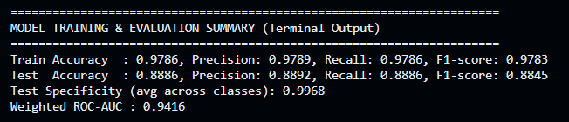
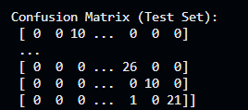
Metrics
BACK TO AGENDA PAGE

Slide 6
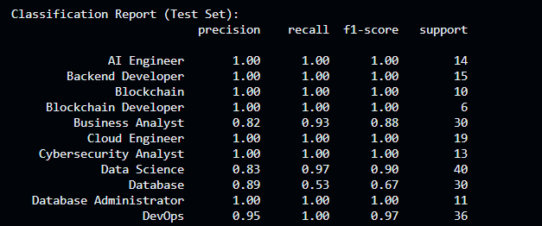

Metrics
BACK TO AGENDA PAGE

Slide 7

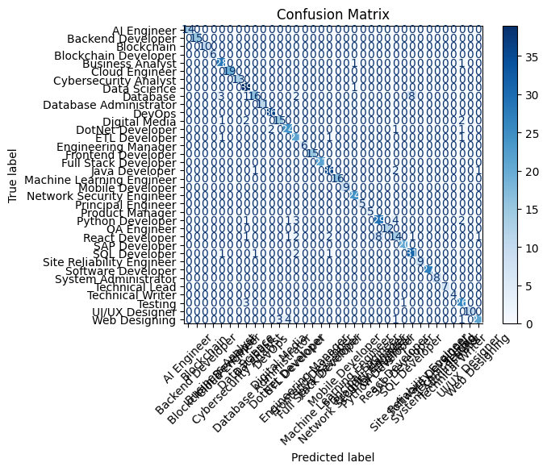
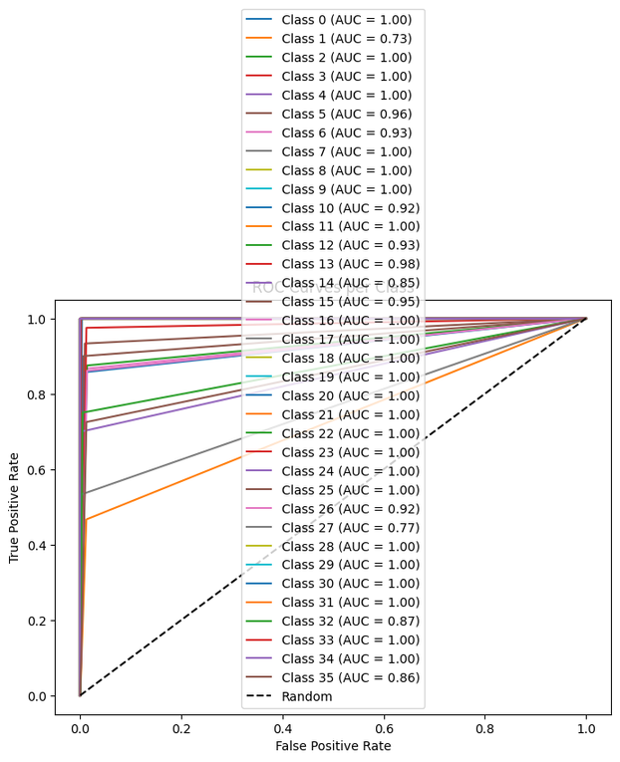
Classification report

Slide 8
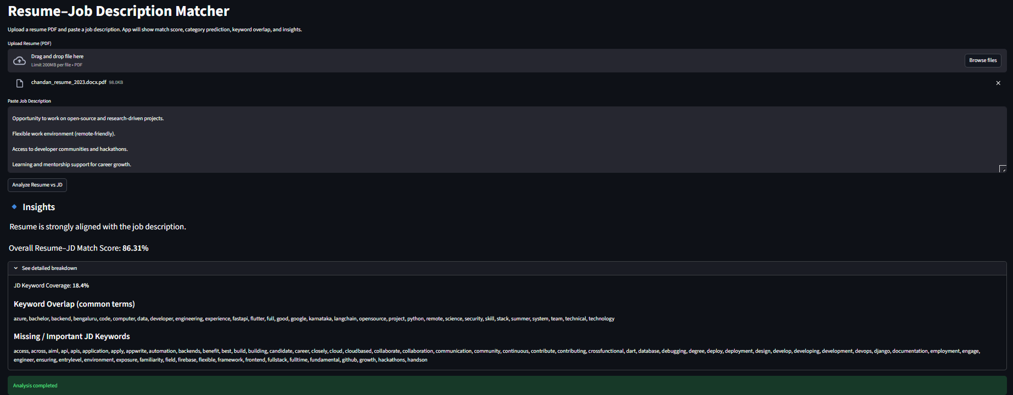
UI Screenshots:

Slide 9
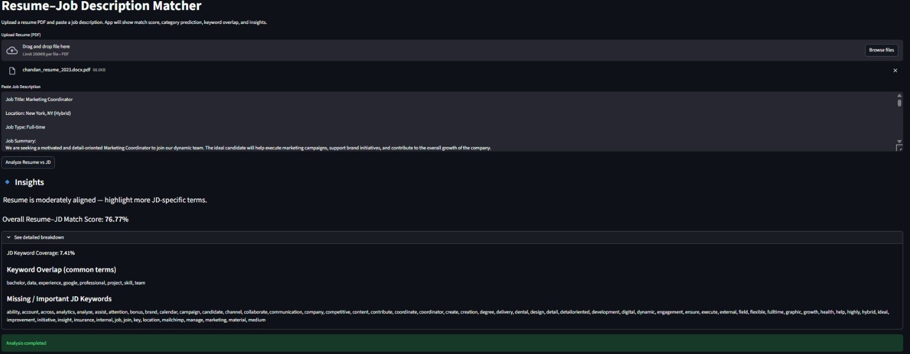
UI Screenshots:

Slide 10
THANK YOU

